Slide 1
Drawing Images with GDI
Programming – Introduction to C#
Last modified 12/12/16 by Alex Mackay

Slide 2
Contents
Preparing to Draw Images
DrawImage
A few examples

Slide 3
Preparing to Draw Images
Drawing images requires a bitmap to either be loaded from file or made manually
Using an Image
Then you just call DrawImage()
Notes:
Technically, Windows uses GDI+, and no longer supports the older GDI

Slide 4
Preparing to Draw Images – From File
The Bitmap constructor allows Bitmaps to be created from a file on disk
You can use the System.Environment.CurrentDirectory to retrieve the working directory of the application
The Bitmap class can load the following file types:
BMP
GIF
EXIF
PNG
TIFF
Notes:
Graphic objects for a form/control can be accessed either by:
1. Accessing the Graphics property of the PaintEventArgs passed into the Paint event of a form.
2. Call the CreateGraphics() function in any code run by a Control or Form to receive the Graphics object for that Control/Form
3. Graphics Objects can be gotten from a Image object, allowing you to render and change a pre-existing image.

Slide 5
Preparing to Draw Images – From File
string fileName = System.Environment.CurrentDirectory +
"\\hangout-smiley-face.jpg";
Bitmap myBitmap = new Bitmap(fileName);
Notes:
Graphic objects for a form/control can be accessed either by:
1. Accessing the Graphics property of the PaintEventArgs passed into the Paint event of a form.
2. Call the CreateGraphics() function in any code run by a Control or Form to receive the Graphics object for that Control/Form
3. Graphics Objects can be gotten from a Image object, allowing you to render and change a pre-existing image.

Slide 6
Preparing to Draw Images - Manually
Create a new Image object
Get its Graphics Object
Draw to it as normal
Create a new bitmap using the Image
Notes:
Graphic objects for a form/control can be accessed either by:
1. Accessing the Graphics property of the PaintEventArgs passed into the Paint event of a form.
2. Call the CreateGraphics() function in any code run by a Control or Form to receive the Graphics object for that Control/Form
3. Graphics Objects can be gotten from a Image object, allowing you to render and change a pre-existing image.

Slide 7
DrawImage
Once you have a Bitmap, simply call DrawImage
g.DrawImage(myBitmap, new Point(100, 100) );
Notes:
Graphic objects for a form/control can be accessed either by:
1. Accessing the Graphics property of the PaintEventArgs passed into the Paint event of a form.
2. Call the CreateGraphics() function in any code run by a Control or Form to receive the Graphics object for that Control/Form
3. Graphics Objects can be gotten from a Image object, allowing you to render and change a pre-existing image.

Slide 8
DrawImage Example
private void RenderTextExample(Graphics g)
{
string fileName = System.Environment.CurrentDirectory
+ "\\hangout-smiley-face.jpg";
Bitmap myBitmap = new Bitmap(fileName);
g.DrawImage(myBitmap, new Point(100, 100) );
}

Slide 9
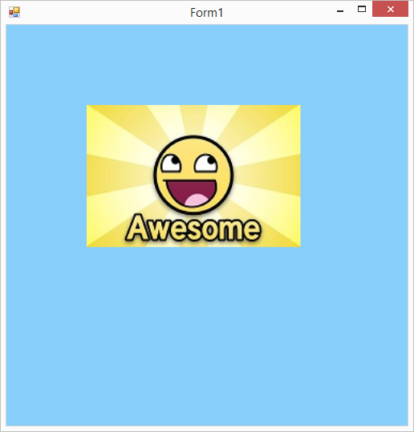
DrawImage Example

Slide 10
Summary
Bitmaps support a number of file types
Or can be created manually
Call DrawImage()

Slide 11
Further Reading
Microsoft, 2016, Rendering Images with GDI+, MSDN
https://msdn.microsoft.com/en-us/library/aa984387(v=vs.71).aspx

